Slide 1
OOP1(JAVA) Project Prototype
JOLLY JUMPER

Slide 2

Submitted By
Islam, Zaedul
ID: 14-26589-2
Roy, Arnab
ID: 14-26473-2
Section: G
Presented to
Shovra Das
Lecturer,
Department of Computer Science
American International University-Bangladesh

Slide 3
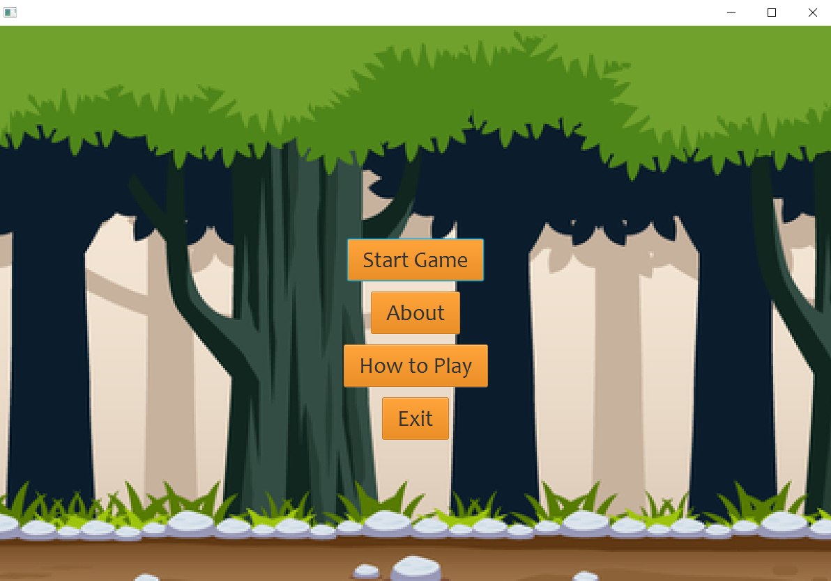
S
T A
R T
S C R E E N

Slide 4
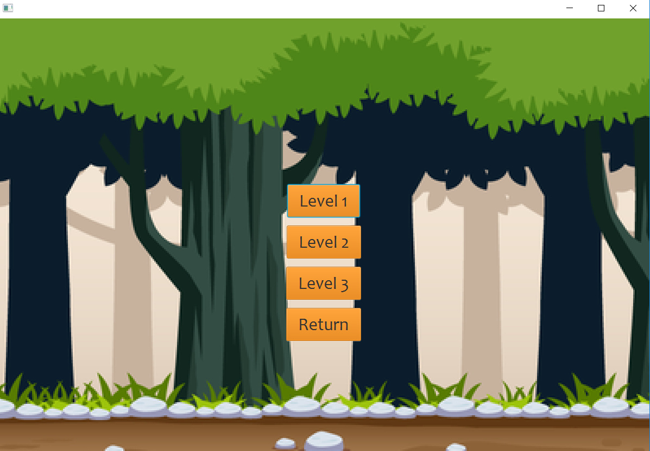
L
EVE
L

Slide 5
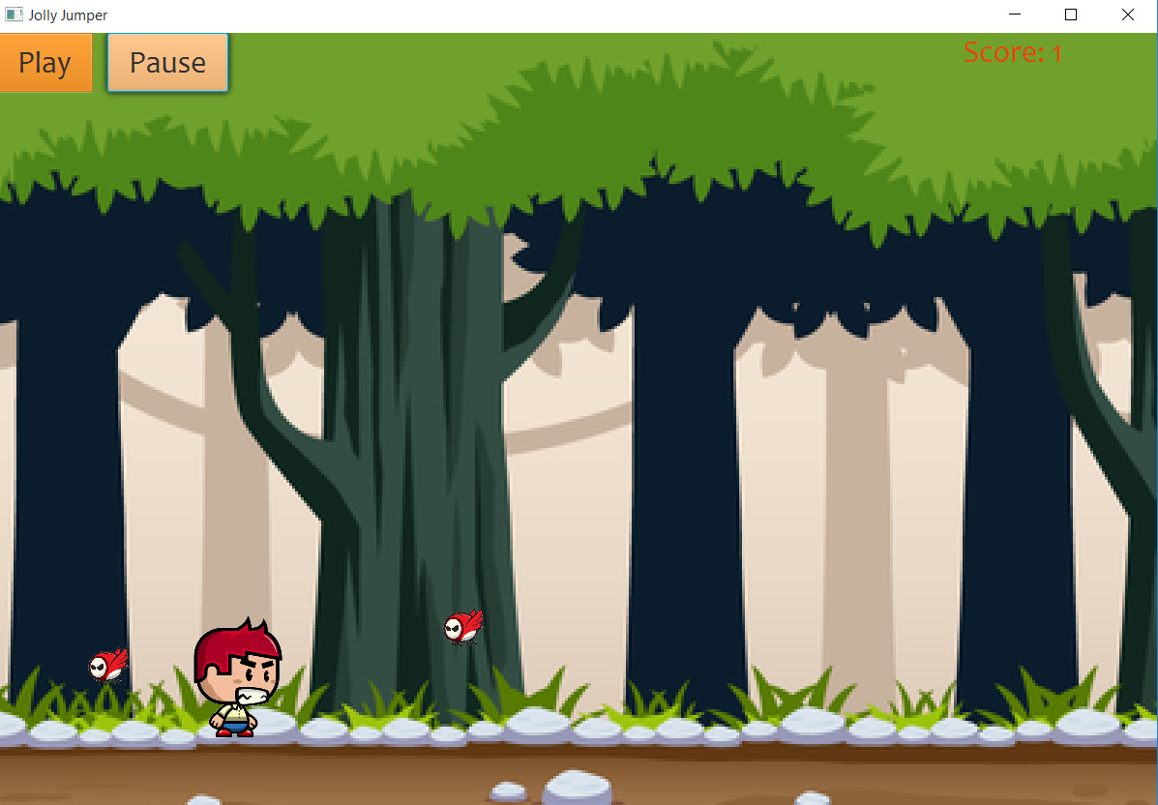
G
A
M
E
W O R L D

Slide 6
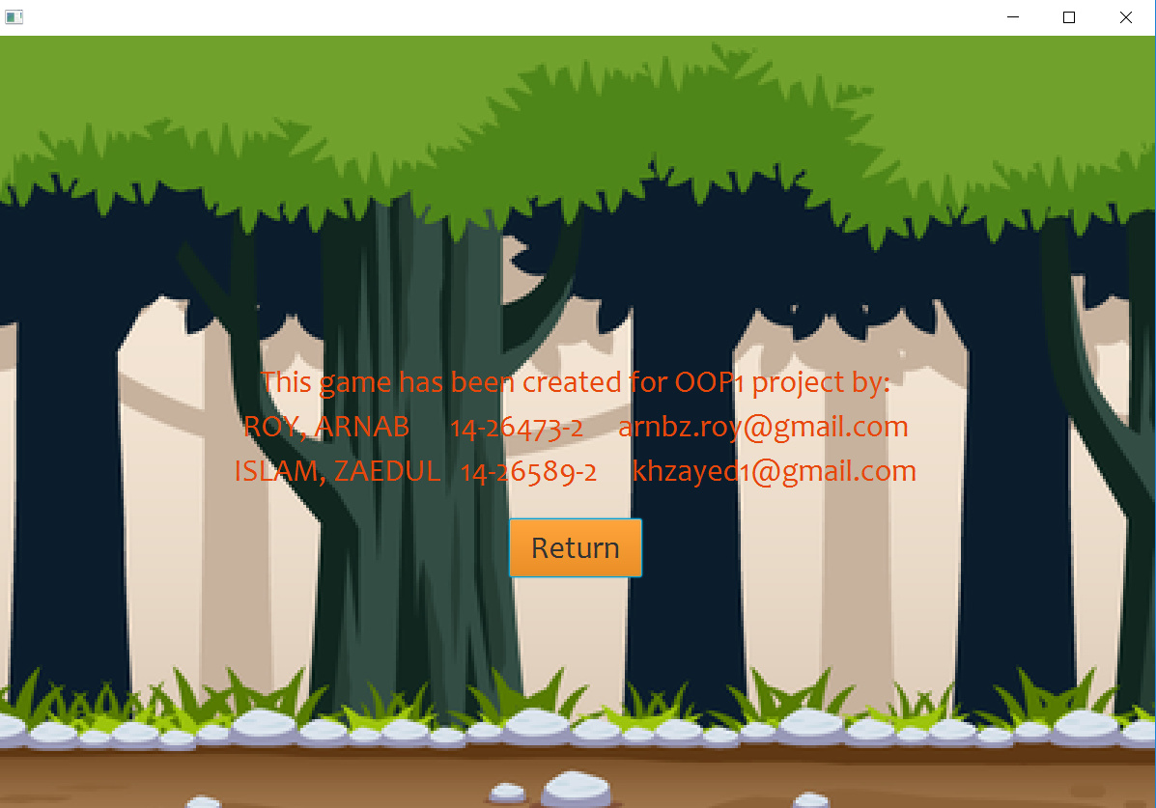
A B O U T

Slide 7
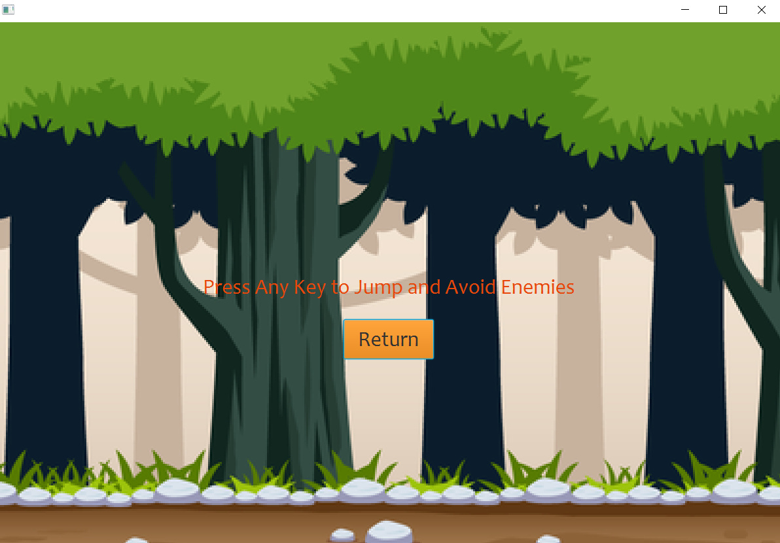
I N S T R U C T I O N

Slide 8
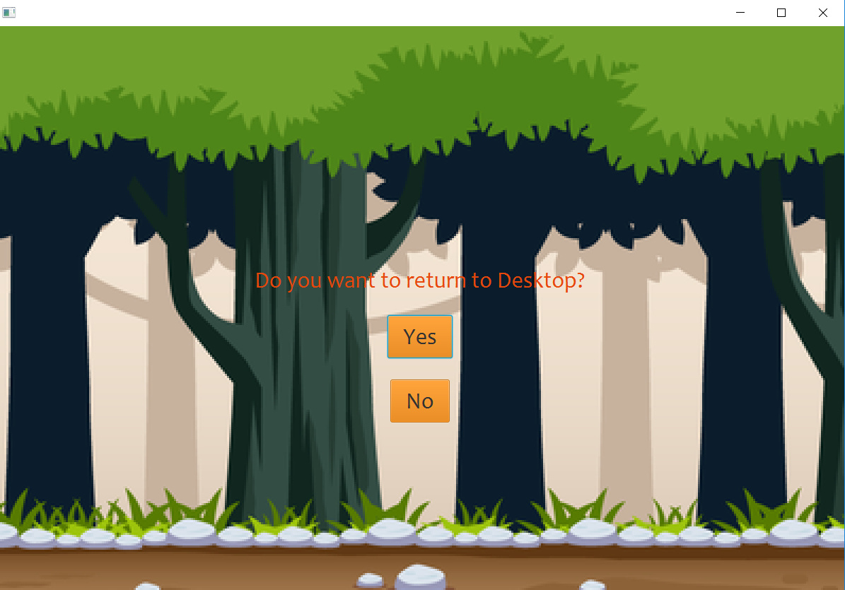
Q U I T

